Slide 1
BOOK LIST SOLUTION
SEARCH IN GRID
FINDInGrid function used:
Takes the value and prints the value inputted
Then a for loop used to get its corresponding span ID of the value
Then using an attribute of the span ID i.e. inner text, it is compared with the value inputted.
If attribute of the span (i.e. inner text) is equal to the value inputted and printed, then the appropriate element is found and the block is highlighted
Note: If the value is not in the grid, the value will be still be displayed in the console, the span ID would not be found and nothing will be highlighted in the grid.

Slide 2
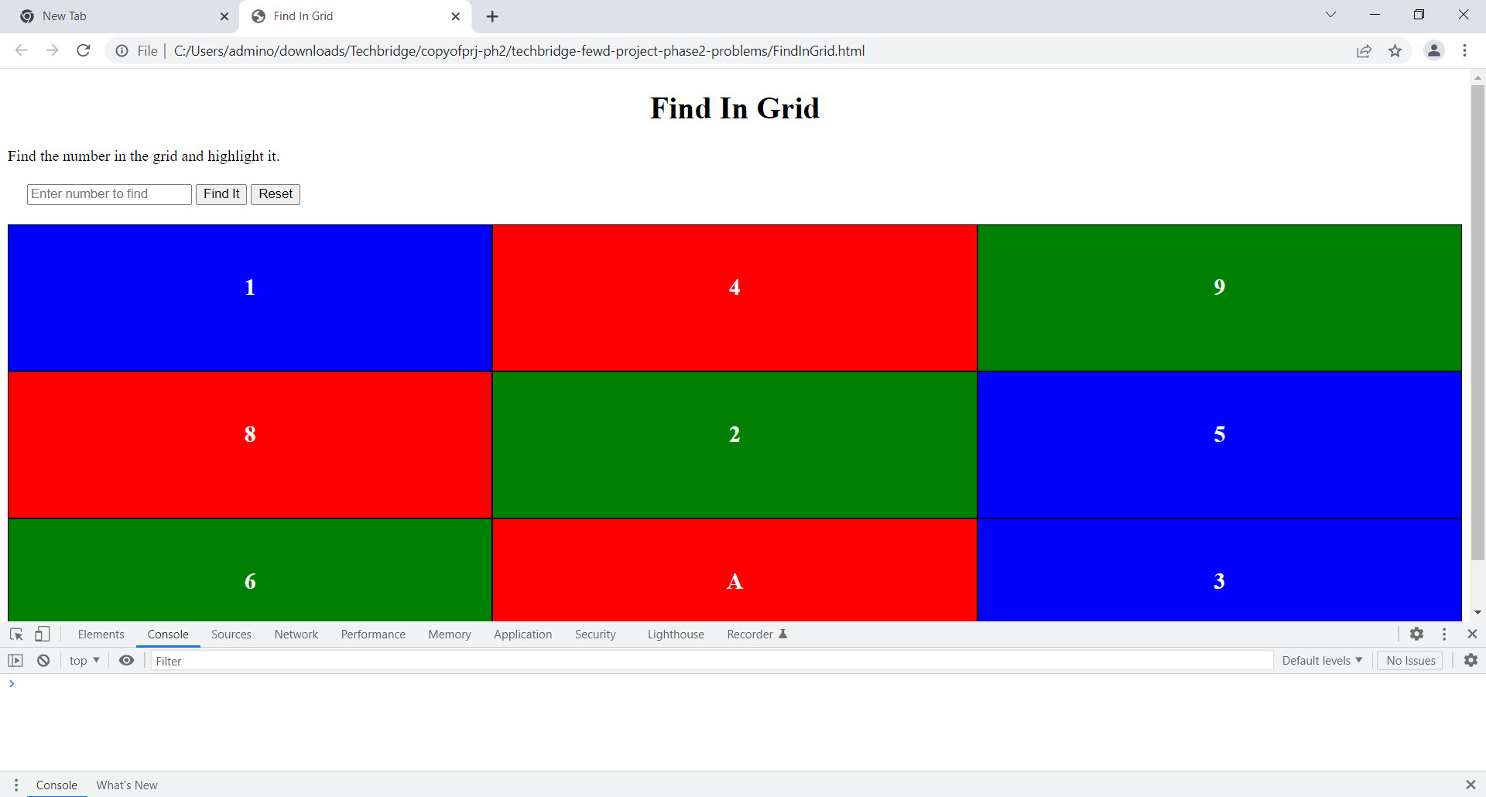
BOOK LIST SOLUTION

Slide 3
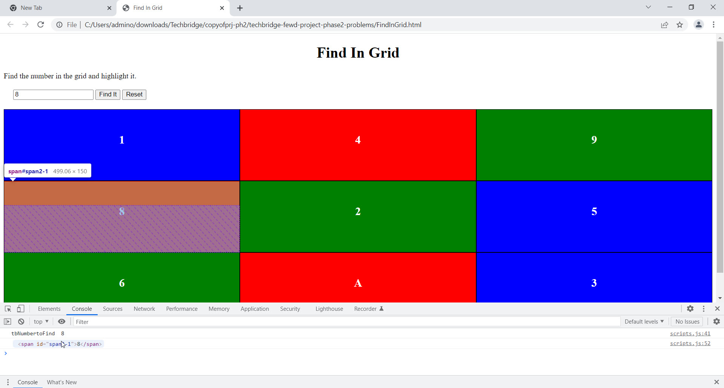
BOOK LIST SOLUTION

Slide 4
BOOK LIST SOLUTION
SEARCH IN LIST
Function FINDInList used:
Text is inputted and the function displays the text value
Then the list of spans was assigned to a variable
A loop is used to compare the attribute inner text (of the span ID) to the text value inputted. If they are equivalent in value, then the respective span-id for the value inputted is found and displayed in the console.
Hence, the block is highlighted because it is the respective element
Note: If the value inputted is not in the list, then no element in the grid will be highlighted.

Slide 5
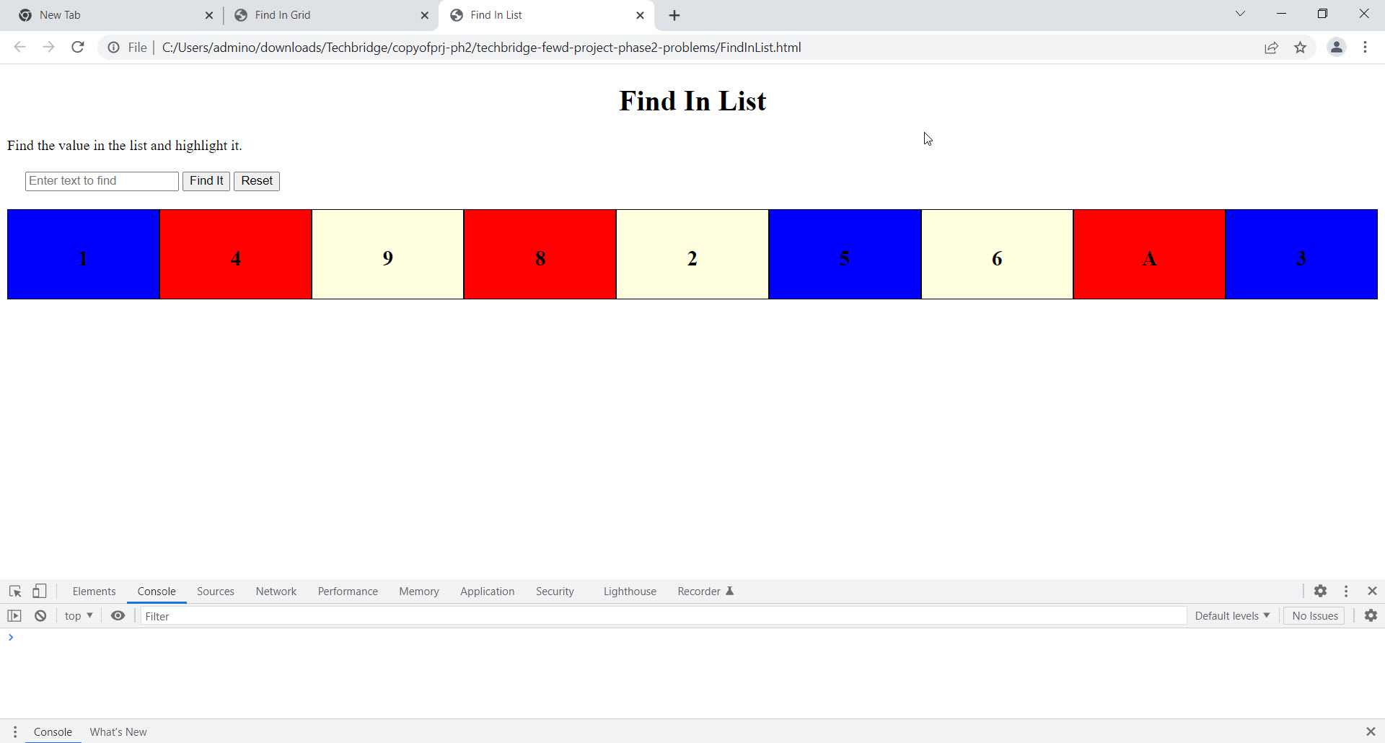
BOOK LIST SOLUTION

Slide 6
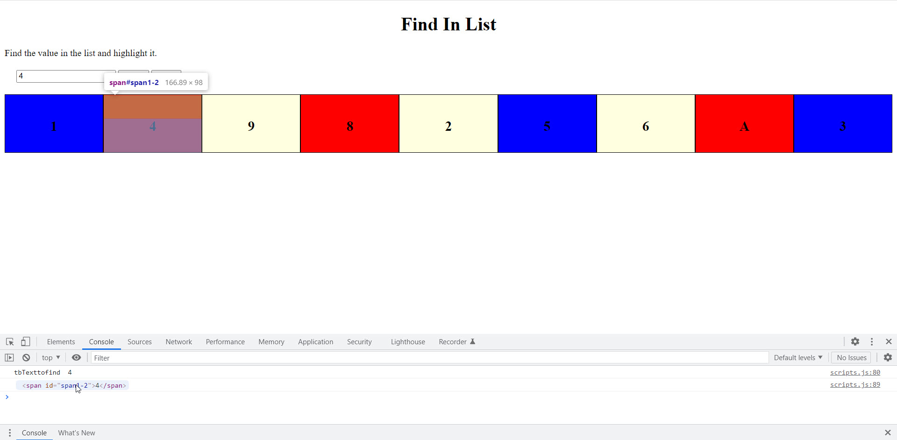
BOOK LIST SOLUTION

Slide 7
BOOK LIST SOLUTION
SORT LIST
Function SortItems used:
An empty array was declared
A span list was created
The span list was assigned to the empty array variable
Each index of the span ID (i.e. 9) along with the “inner text” attribute of the span-id was assigned to equivalent index of the empty array
Then the list was sorted using the sort()method via the attribute inner text (of the span-id)

Slide 8
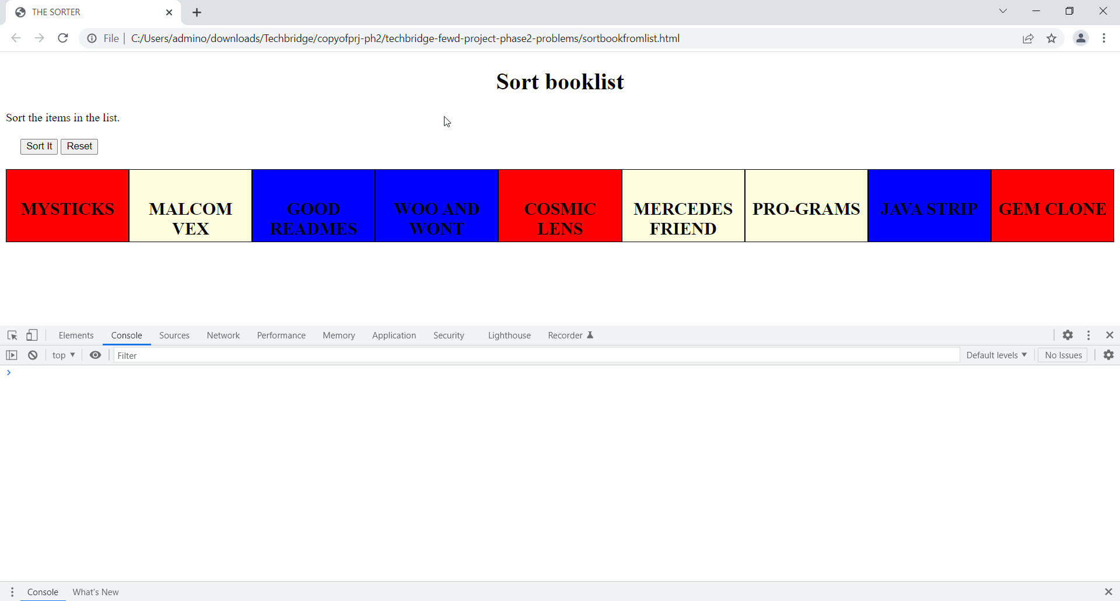
BOOK LIST SOLUTION

Slide 9
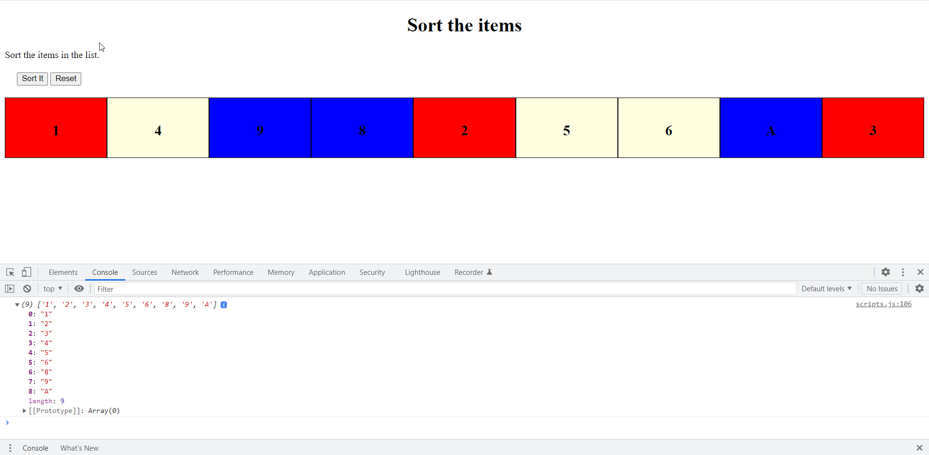
BOOK LIST SOLUTION

Slide 10
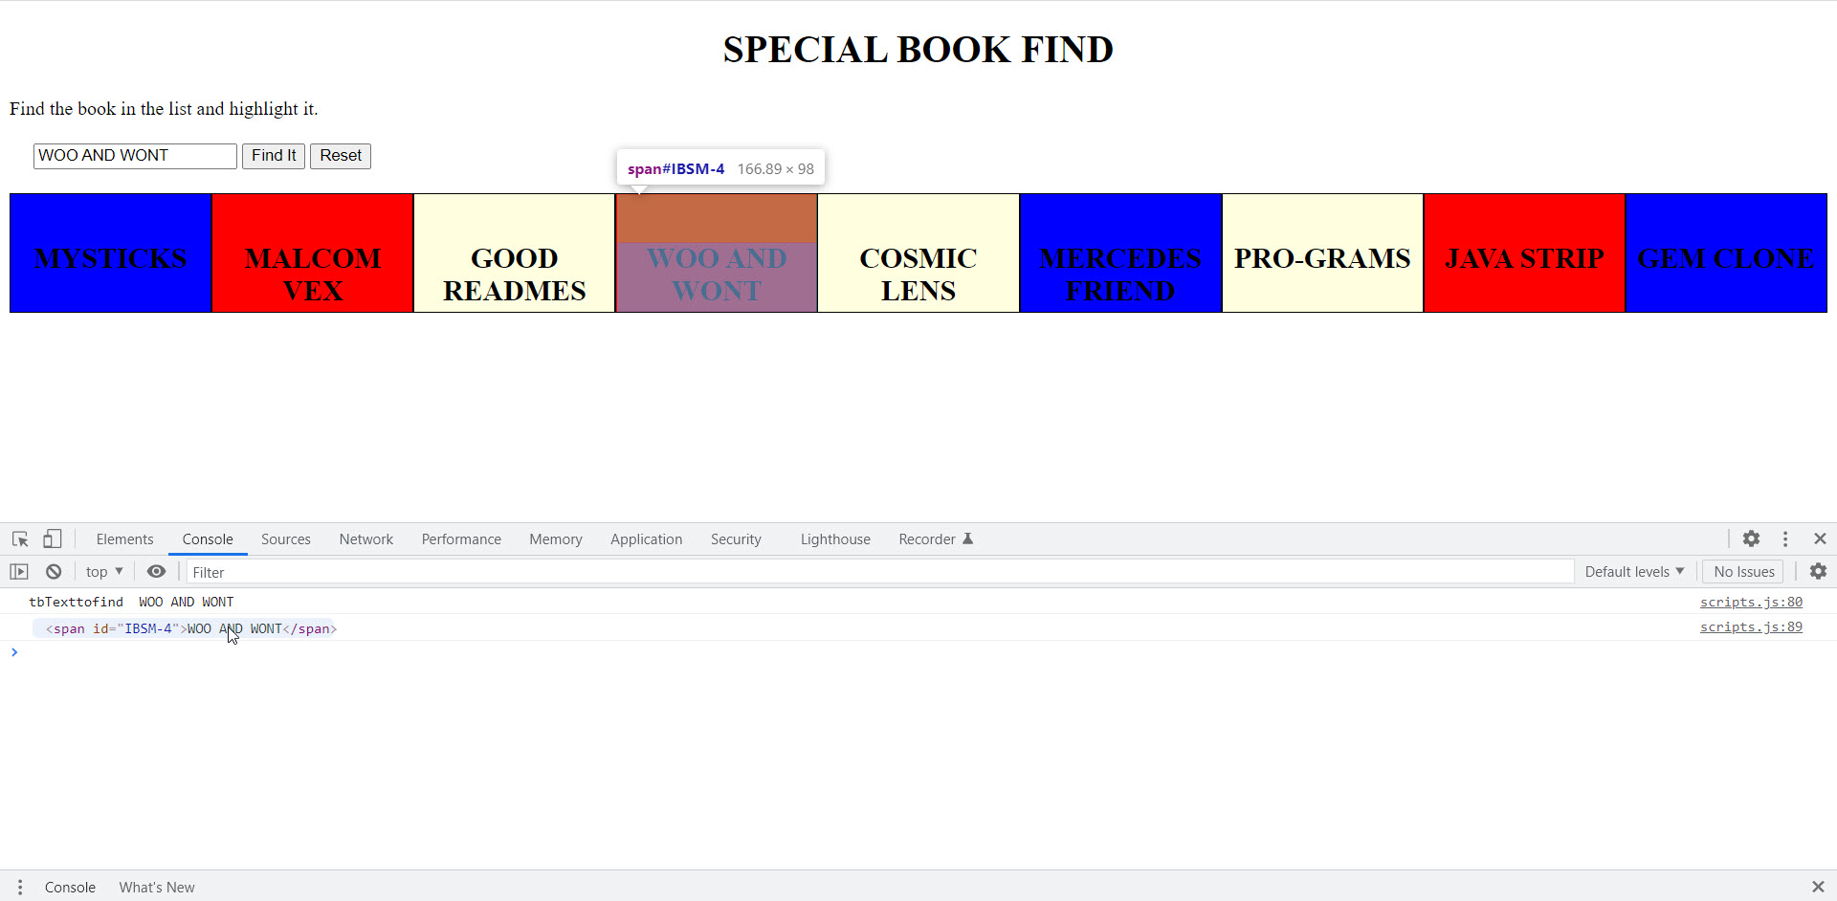
BOOK LIST SOLUTION

Slide 11
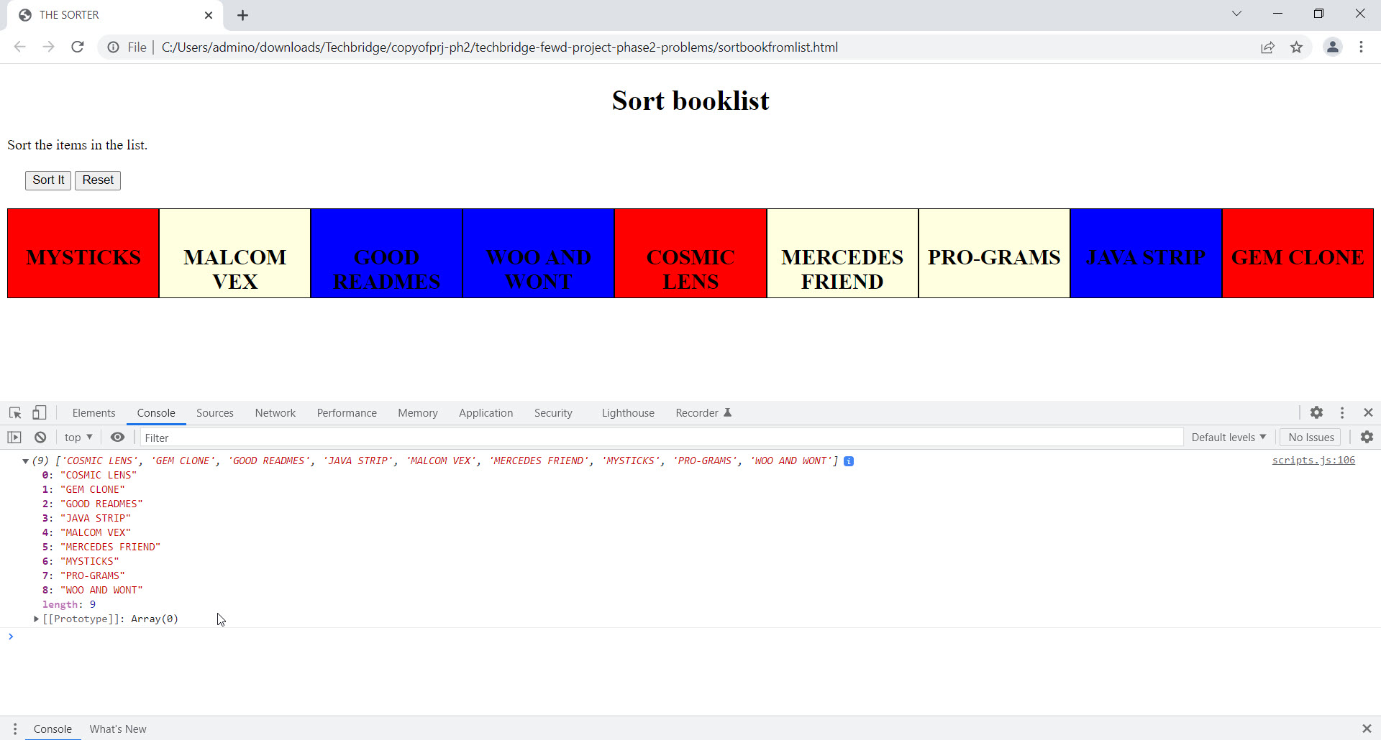
BOOK LIST SOLUTION

